Slide 1

Closer look at the Engulfing pattern
Data Science research final project by:
Denzel Tatenda Chikaka

Slide 2
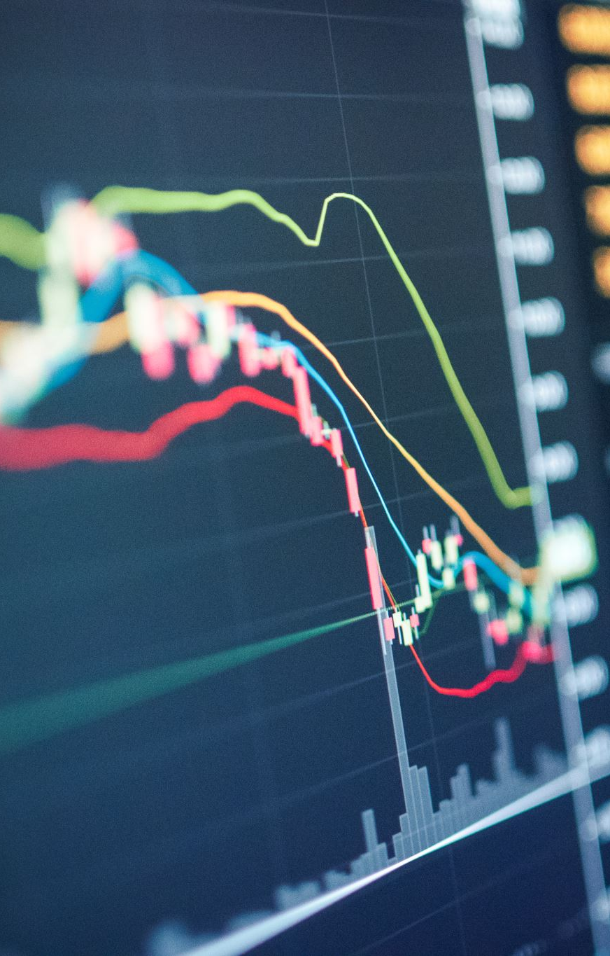
Intro
I personally have been a day trader for quite some time on the online financial markets. After some significant losses and some wins I, over the years have learnt that for one to be a consistently profitable trader one has to be disciplined and learn to trade without emotion as much as possible. However due to my human nature this has proven difficult, unlike computer which basically run on rules. In this project I set out to really investigate how much consistency and discipline pays in this business by analysing and gathering as much data as possible to automate one of the simplest trading strategies there is, which is basically known by almost every trader but the majority fail to make it profitable due to consistency issues and emotional trading, The Engulfing Pattern.

Slide 3

Objectives
Create a program that runs through the dataframe and identify the engulfing pattern
Calculates the Take-profit and Stop-loss values once it identifies the pattern – which would be used for paper trading.
Create a automatic paper trading function that runs simulations on these patterns to determine their success rate and other data using a risk to reward ratio of 1:2.
Collect and record the trading data and add it to the dataframe.
Find a way to use machine learning on the data recorded from these trades to maximize revenue.
Extract the data for visualization for analysis and insights through a streamlit application

Slide 4
Structure
main.py
The main.py is where the streamlit app code is.
“charts.py” is where most of the plotly charts code is which is imported into the main and displayed by the streamlit app.
“Engulfing_project.py” file is where most of the cleaning, processing and analyses code is done on the data set and later called imported into the other files.
“testchart.py” file is where the code for the machine learning model is.
charts.py
Engulfing_project.py
Testchart.py

Slide 5
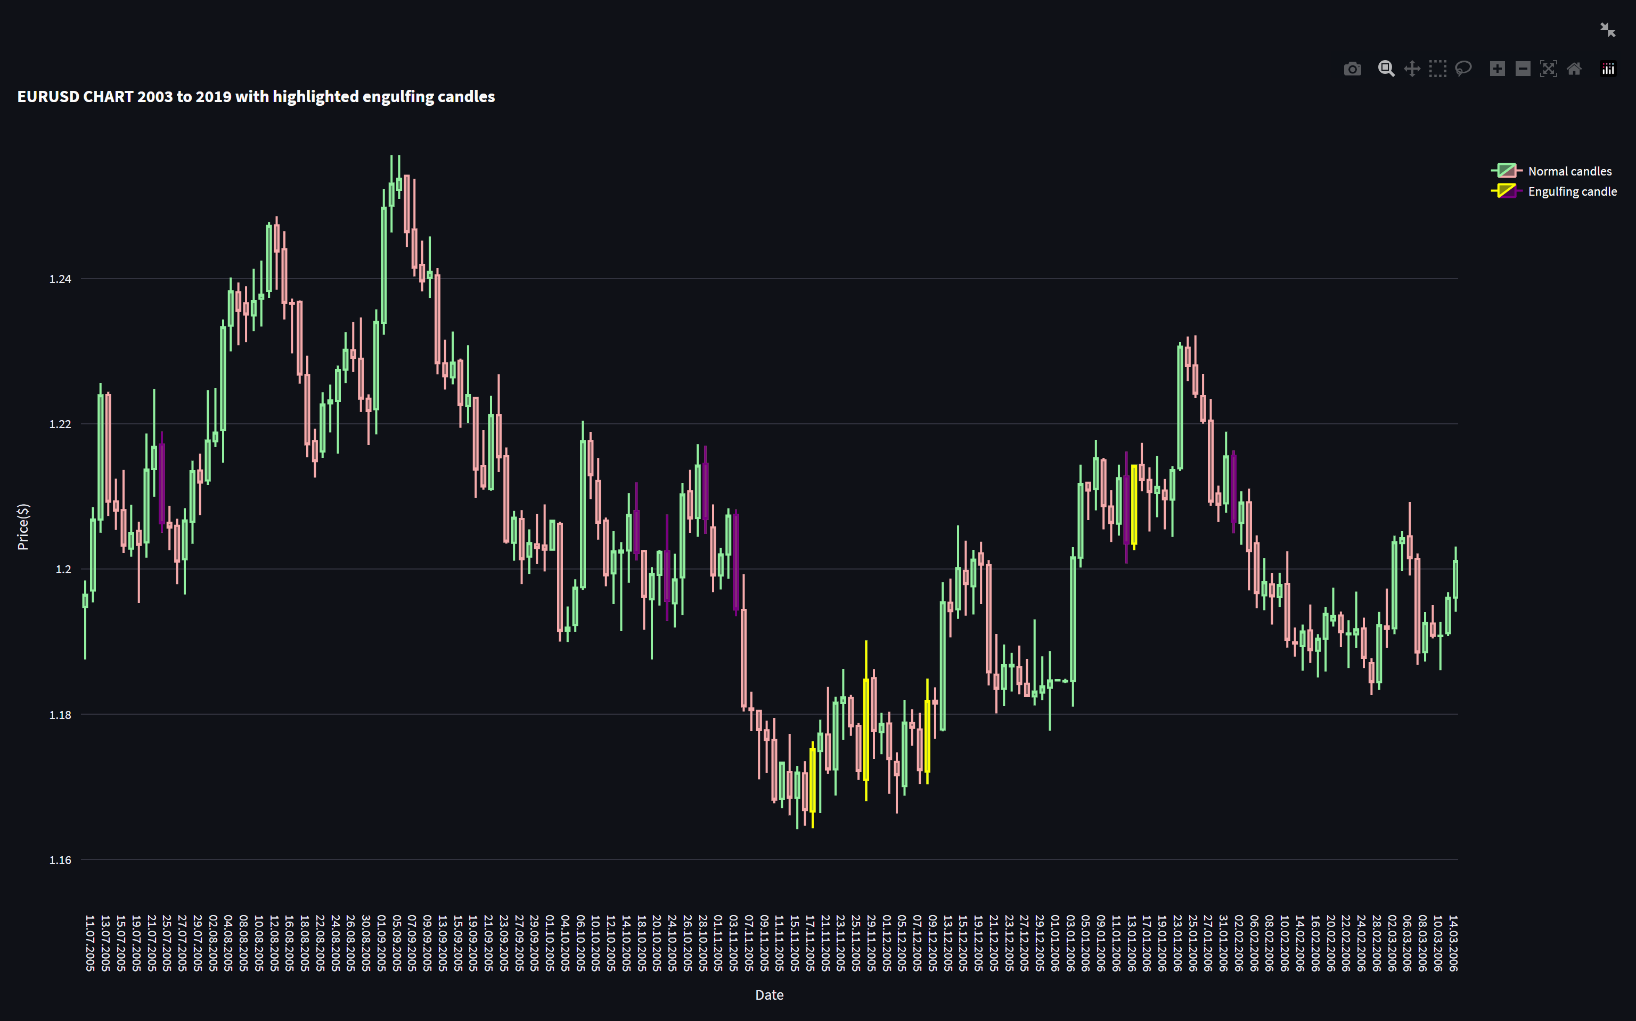
Candlestick chart
Plotly chart displaying the candlesticks from the dataset with a trace to highlight the engulfing candles on the chart in different colors (purple for the bearish and yellow for the bullish engulfing.

Slide 6
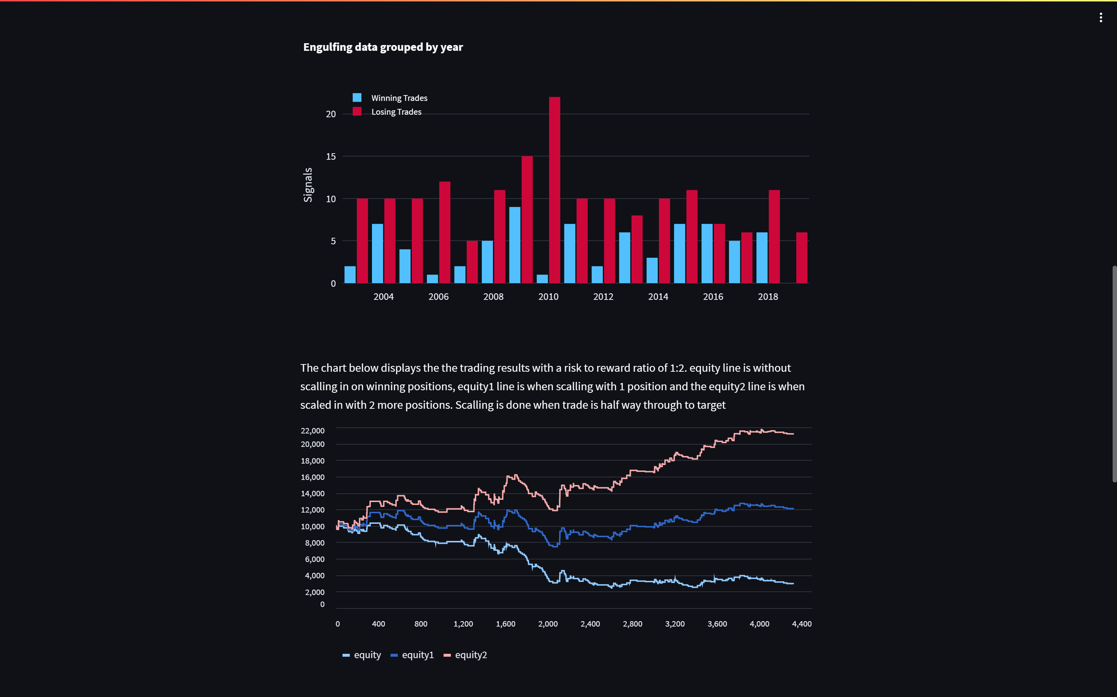
The bar chart displays the numbers of engulfing patterns per year and the of winning to losing trades based of these patterns per year
The chart below displays how these trades would have affected a trading account with a starting equity of $10000. “equity line displaying outcome without adding on to winners. “equity1 showing if they are traded with one extra entry added to the winning entry half - way through (scaling in) and the “equity2” showing outcome if 2 more positions are added to the winning position half - way through.

Slide 7
Scaling in on the winning trades
According to my findings, trading on the daily chart from May 2003 to October 2019 for a total of over 4300 days. There were about 248 engulfing patterns detected and all of them. 174 of those patterns were losing trades using a risk to ratio of 1:2 which is my personal minimum but those numbers decreased a little as I would shorten the reward target and vice-versa. 74 of the 248 were winners making the pattern 42.5% reliable in the 16 years.
Returns outcome now come down to how these winning trades are handled. If one finds a way to add and maximise on the winning trades efficiently they would overall become profitable and this is where the concept of scaling in would come in. However simply entering another trade because another is in profit is not a very efficient way to handle risk management. Those who can pull it of have a grat deal of expertise and experience on their side and it’s not as easy as may sound and to control your emotions which may lead to unnecessary loses and this is where machine learning comes in. To try and learn from the data fo previous winners and try to identify higher probability patterns in the future. A machine learning signal, combined with my own would for confirmation will greatly help the odds go in my favor. This is where I used the RandomForestClassifier from sklearn to try and detect good engulfing patterns in the future.

Slide 8
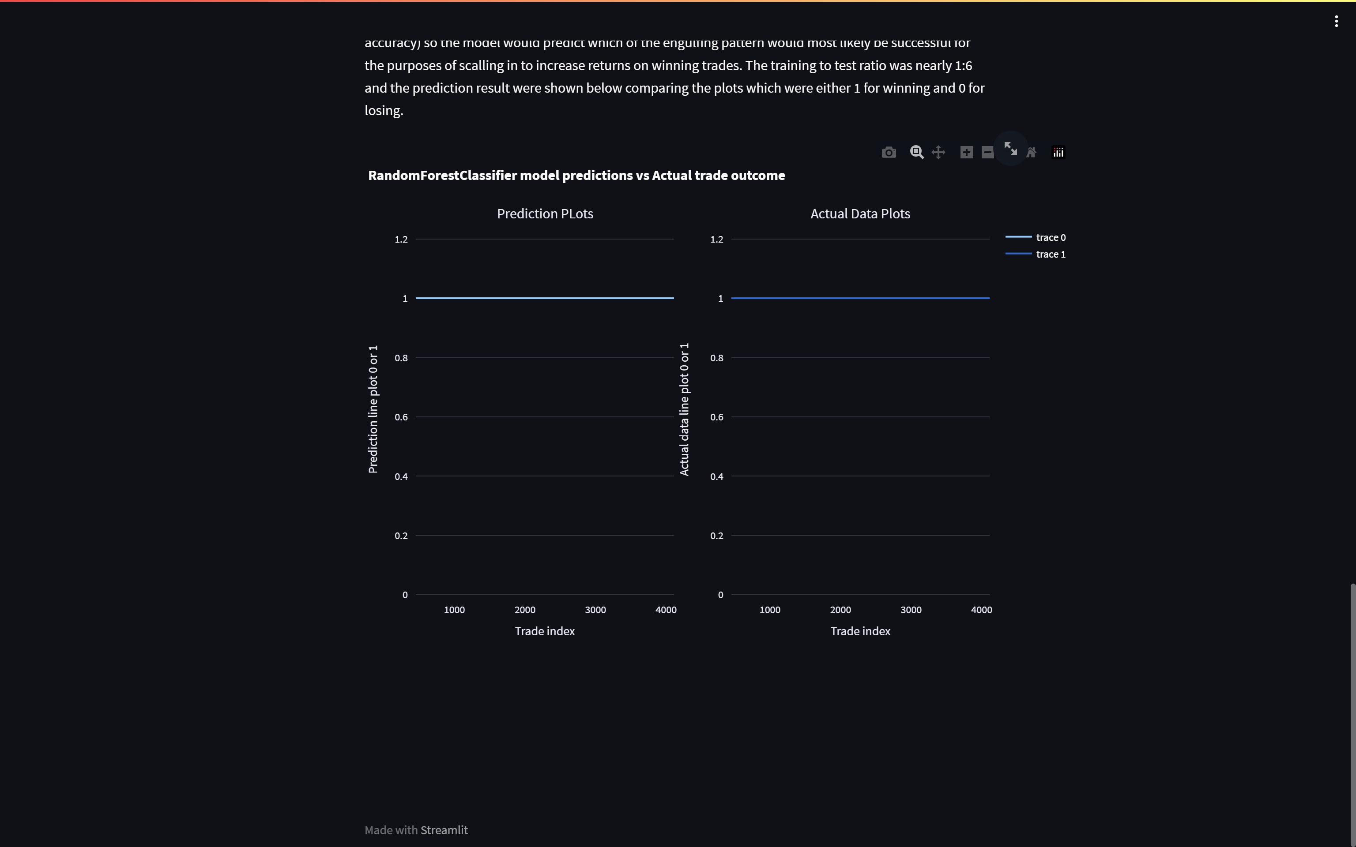
A new dataframe was used to train the with values as the Open, High,Close,Low and volume data and also some of the data I had extracted from the dataset such as the candle body difference between the candlesticks and how also how far up or down the price had gone after the engulfing.
The goal was the model to produce either a 1 or 0 in “Win” column of the dataframe and compare the data with the actual outcome. There wasn’t too much data to feed it more but after feeding the model about 1/6 of the winning data and using the data to plot a subplot chart and the result were below. Quite promising but I would still wait and feed it more data as to make it much better.

Slide 9
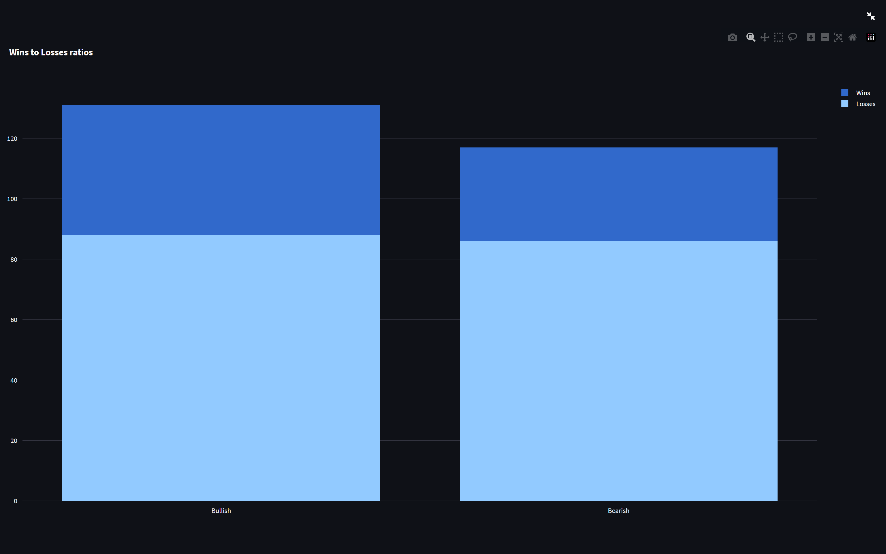
Key take-aways
The engulfing pattern is only profitable traded manually when the trader is experienced and disciplined. I don’t believe it is as “beginner friendly” as the world has portrayed it to be. Over half of them according to this research produce little to no returns at all, consistence and emotionless discipline after such results is almost impossible/greatly difficult for the average trader.
Best results can be obtained from algorithmic trading an example of which I used to attain these results.

Slide 10
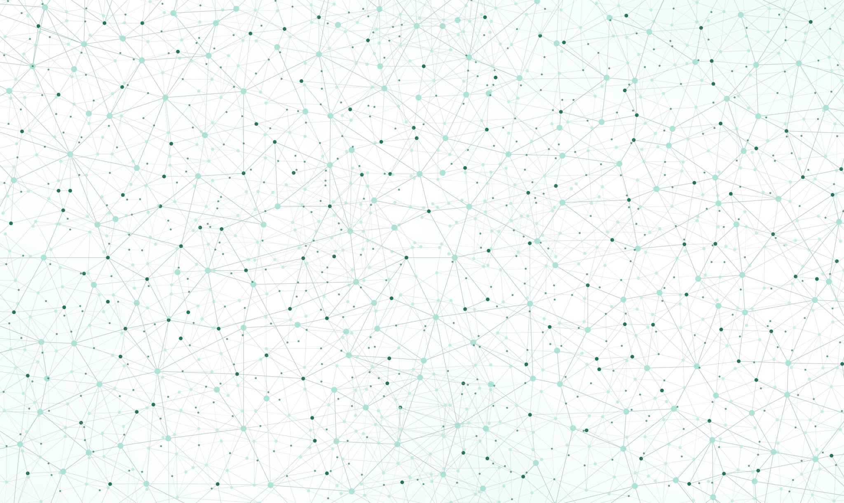
Project by : Denzel chikaka
Thank you

